Slide 1
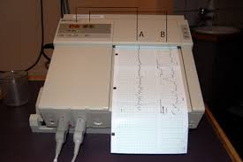
Foetal (heart) monitor
principles of operation
function
use
scientific principles
construction
components
system diagram
inputs/outputs
troubleshooting
identifying common faults
replacing components
rectifying faults
safety considerations
user and patient safety
electrical safety
18.2.3 Foetal Heart Monitor
Unit C 18.2 Maintaining Gynaecology and Obstetrics equipment
Module 279 19 C Medical Instrumentation II
©
dr. Chris R. Mol, BME, NORTEC, 2015

Slide 2
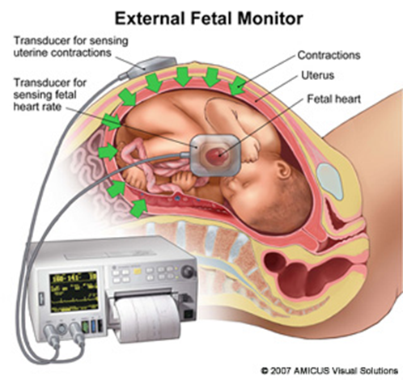
Function
With a fetal monitor (or: CardioTocoGraph, CTG) you can measure:
the heart rate of the fetus with Doppler Ultrasound
the strength and duration of uterine contractions of the mother during labour
Electronic fetal heart monitoring can be done during pregnancy, (from 26 weeks onwards), labor and delivery. Fetal heart rate monitoring is especially helpful for high-risk pregnancy conditions such as diabetes, high blood pressure, etc.
A normal fetal heart rate is between 110 to 160 beats a minute. The sound of the beat is usually strong and regular. It is normal to have some changes in the fetal heart rate during labor, but drastic changes in heart rate before or after a contraction may indicate that the fetus is in distress. A fetus with large changes in heart rate may need to be removed from the womb immediately, by Caesarean section.
©
Foetal Heart Monitor
dr. Chris R. Mol, BME, NORTEC, 2015

Slide 3
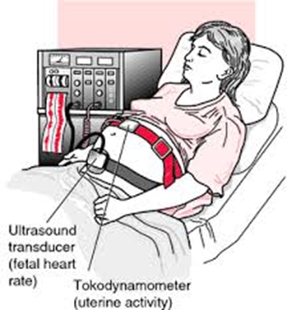
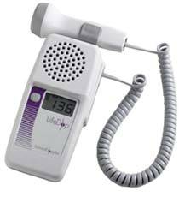
Fetal heart rate with ultrasound Doppler technique
For the Doppler technique, a nurse applies ultrasound gel to the end of a flat transducer and moves it across the abdomen until a good reflection is found from the fetal heart.
The Doppler technique is the most common as it is less prone to artefacts than the surface electrodes and it is easy to apply.
However, the transducer and accompanying electronics are expensive, may require repositioning during labor, and don’t resolve multiple fetal pregnancies well.
During pregnancy (from 12 weeks onwards) the heart rate of the fetus can be measured with a (stand alone) hand-held electronic Doppler ultrasound device.
©
Foetal Heart Monitor
dr. Chris R. Mol, BME, NORTEC, 2015

Slide 4
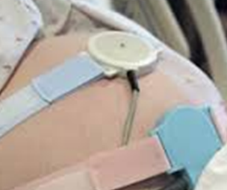
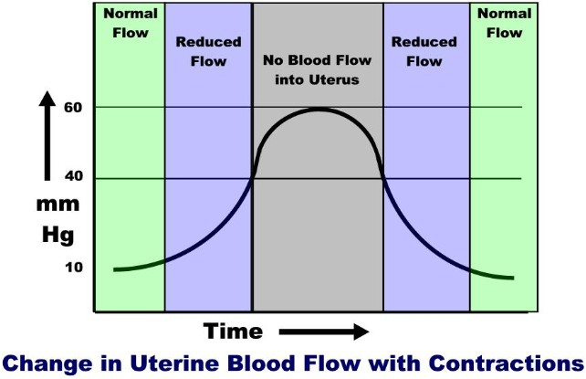
Uterine contractions
Uterine contractions are measured with a strain gage transducer or pressure sensor usually strapped with a belt around the abdomen positioned over the fundus (top) of the uterus. This indirectly records contractions through sensing changes in skin tension arising from the uterine muscular activity.
During labour, it is important to have some indication of how labour is progressing, and to monitor the build-up of contractions, both in terms of frequency and strength. Such contractions have a powerful impact on the fetus. Therefore, fetal heart rate is measured simultaneously.
uterine
contractions
©
Foetal Heart Monitor
dr. Chris R. Mol, BME, NORTEC, 2015

Slide 5
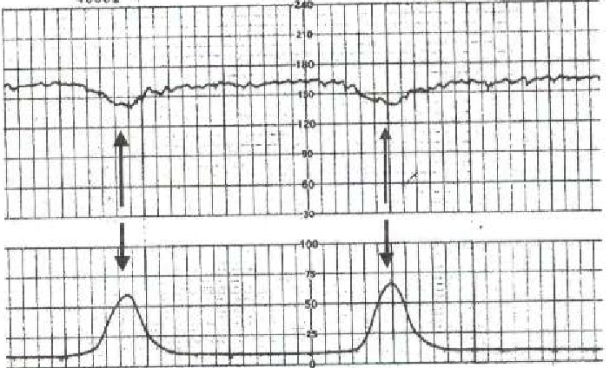
Use
During (uterine) contractions the heart rate will decrease and revert to previous levels after the end of the contraction. If there is a delay in the heart rate returning to its previous level it can indicate that there is fetal distress.
fetal heart rate
contractions
In labour, pregnant women are typically monitored continuously throughout labour, right up to delivery.
©
Foetal Heart Monitor
dr. Chris R. Mol, BME, NORTEC, 2015

Slide 6
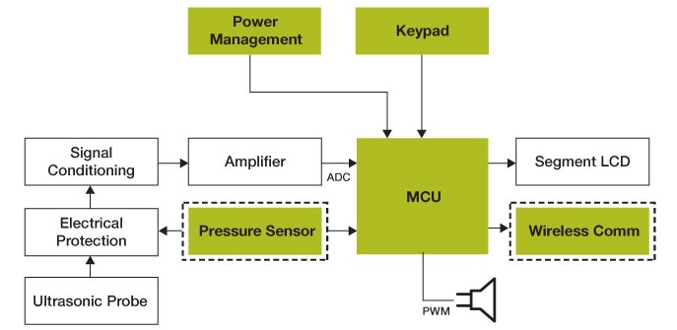
System diagram
©
Foetal Heart Monitor
dr. Chris R. Mol, BME, NORTEC, 2015

Slide 7
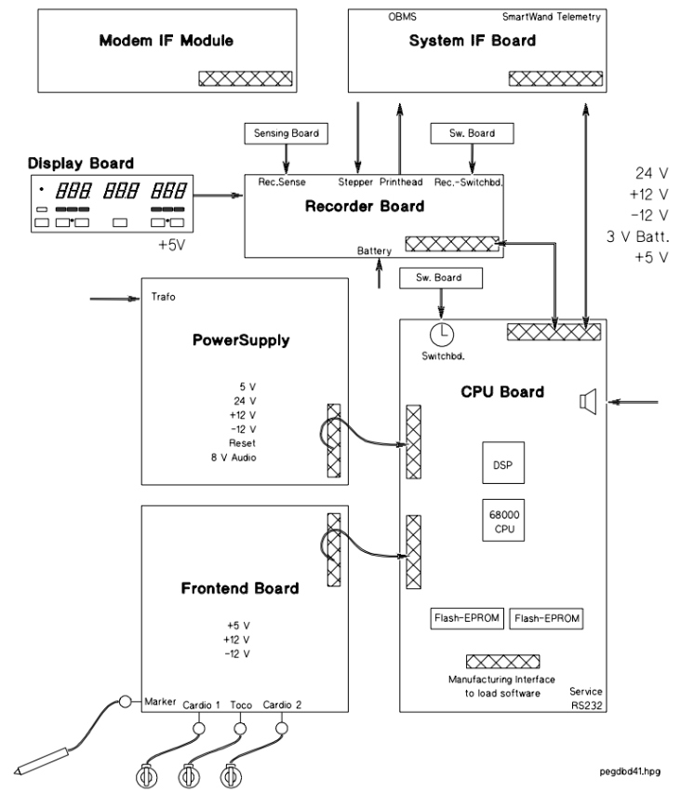
System diagram (example)
Find the Service Doc !
©
Foetal Heart Monitor
dr. Chris R. Mol, BME, NORTEC, 2015

Slide 8
PCB boards (example)
Front End Board
CPU Board
©
Foetal Heart Monitor
dr. Chris R. Mol, BME, NORTEC, 2015

Slide 9
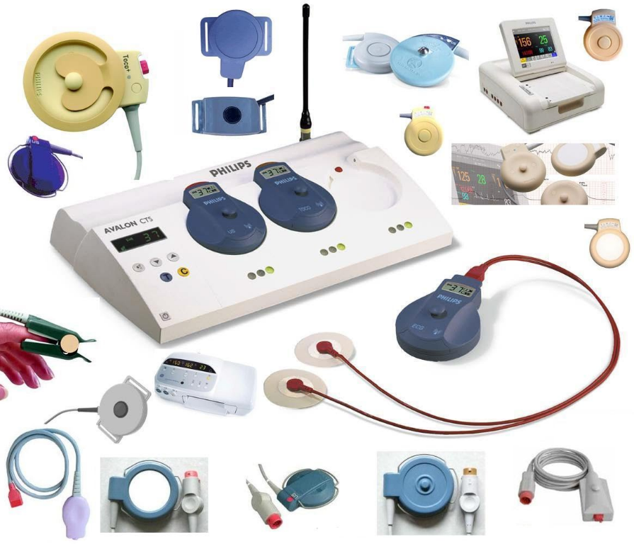
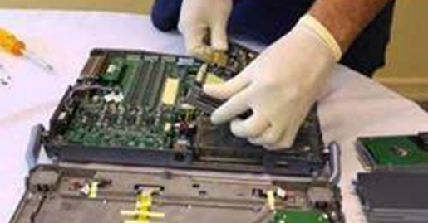
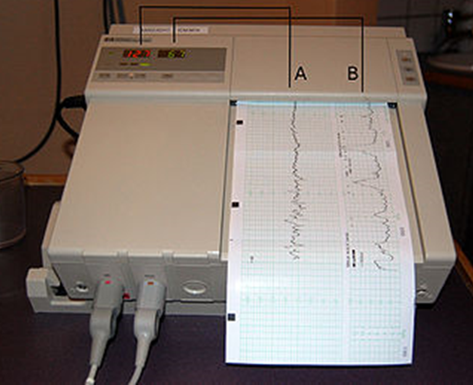
Components
©
Foetal Heart Monitor
dr. Chris R. Mol, BME, NORTEC, 2015

Slide 10
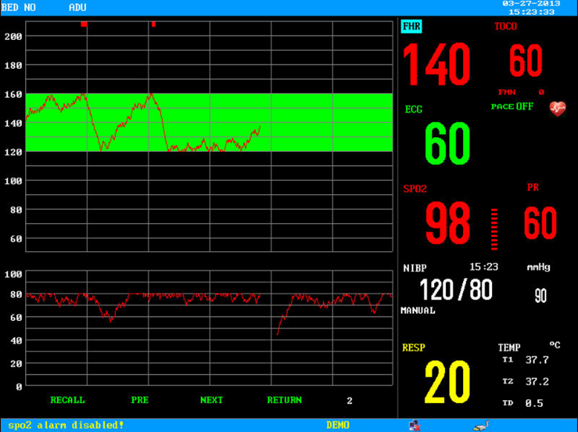
troubleshooting: User Error
User errors are common with fetal monitoring, e.g.
Incorrect connections of the transducers
Incorrect loading of the paper or loading of the wrong paper
Lack of gel – gel can dry out over a period of time in long labour monitoring sessions; gels may flow away from where it’s needed.
Loose belt – it is important to apply enough belt tension to ensure that firm contact with the skin is maintained.
Transducer movement – it may have slipped due to maternal movement, pulling the cable, etc.
Fetal movement – the fetus may have moved out of the ultrasound beam
Poor transducer positioning. This is an acquired skill and should include palpation of the fetus to determine the best position for the transducer (over the fetal left shoulder blade).
©
Foetal Heart Monitor
dr. Chris R. Mol, BME, NORTEC, 2015

Slide 11
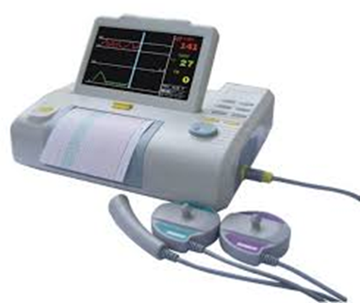
troubleshooting: Other common faults
Power supply problems, typically dead batteries, are common with the hand held fetal Doppler devices.
Be sure that gel is being used between the ultrasonic transducer and the patient.
The Doppler probe is the most sensitive part of both the handheld and bedside devices. When it breaks no output is heard, even when a stethoscope indicates the presence of a fetal heart beat. You can check the probe operation by gently tapping the probe surface about once per second. If this is not detected, there is certainly a probe problem.
The probe consists of the transducer assembly, the cable, and a multi-pin fixable connector. The cable contains between 5 and 80 separate conductors. The most frequent malfunction occurs as a result of a break in one or more of the cable conductors. Such malfunctions are usually the result of mishandling of the cable or of soaking it with gel.
The probe is expensive and typically cannot be replaced. Fortunately, the cable can often be mended.
The face of the probe is usually an acoustic lens. It must be handled with care. Do not drop the probe, and avoid scratching the face with sharp objects. Keep the probe assembly clean of oil and gel. Always clean the probe and cable with a tissue or damp cloth, after finishing work.
©
Foetal Heart Monitor
dr. Chris R. Mol, BME, NORTEC, 2015

Slide 12
Performance Check
The Doppler probe should work when placed on your chest, with the proper gel, near your heart. Check for the accuracy of both the digital display and the paper trace by comparing their output with a measure of your own heart rate from a watch. The two should be within 1 or 2 beats per minute of the correct rate.
For the contraction monitor, stretch the belt, or very gently press on the transducer at a rate of about one gentle push every minute. Use a watch to verify the time between applications. The monitor should reflect your application pressure (approximately) and rate (accurately – about 10%).
If both contraction rate and fetal heart rate are reported accurately, then the device is ready to release to the floor.
electrical safety test !
©
Foetal Heart Monitor
dr. Chris R. Mol, BME, NORTEC, 2015

Slide 13
END
The creation of this presentation was supported by a grant from THET:
see https://www.thet.org/

